Slide 1
Topic
Using our Tools for
Model Driven Language Development
Based on the online tutorial available at
http://www2.informatik.hu-berlin.de /sam/meta-tools/tools.html
Andreas Blunk
blunk@informatik.hu-berlin.de
Forschungsseminar ULF, 22.05.2007

Slide 2
Agenda
Introduction
DSL for demonstration
  Composite State Automatons
  Tool usage
  Difficulties
Outlook
  „Studienarbeit“

Slide 3
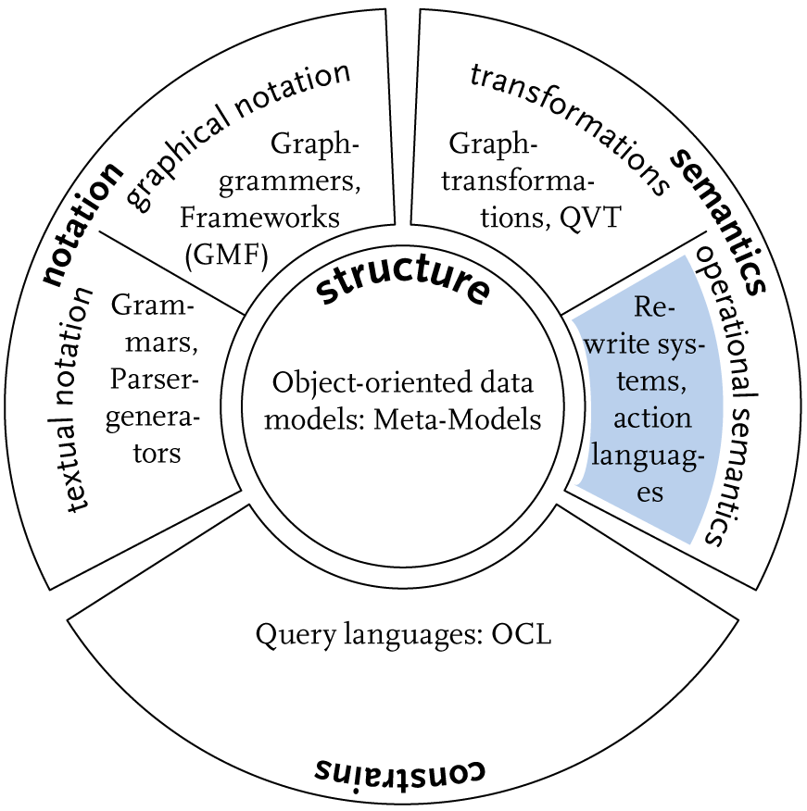
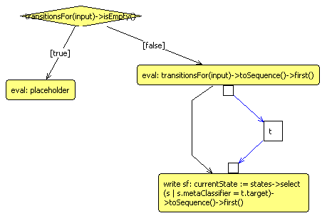
Introduction
MAS = Mof Action Semantics
GEF,
early MAS
MAS,
editor
integration,
deployment
tutorial
now
?

Slide 4
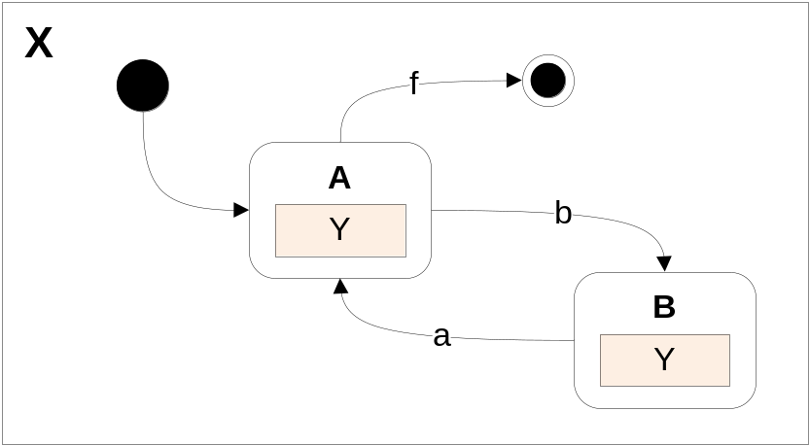
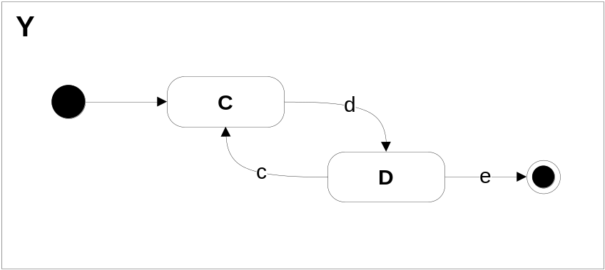
Composite State Automatons
Concepts: automaton, state, transition
Composite states contain a sub-automaton
-> allows reuse of modelled automatons
Consume a sequence of input tokens
Transition between states (one current state)
If no active transition & composite state: forward consume to sub-automaton
Input sequence: dbdecacf

Slide 5
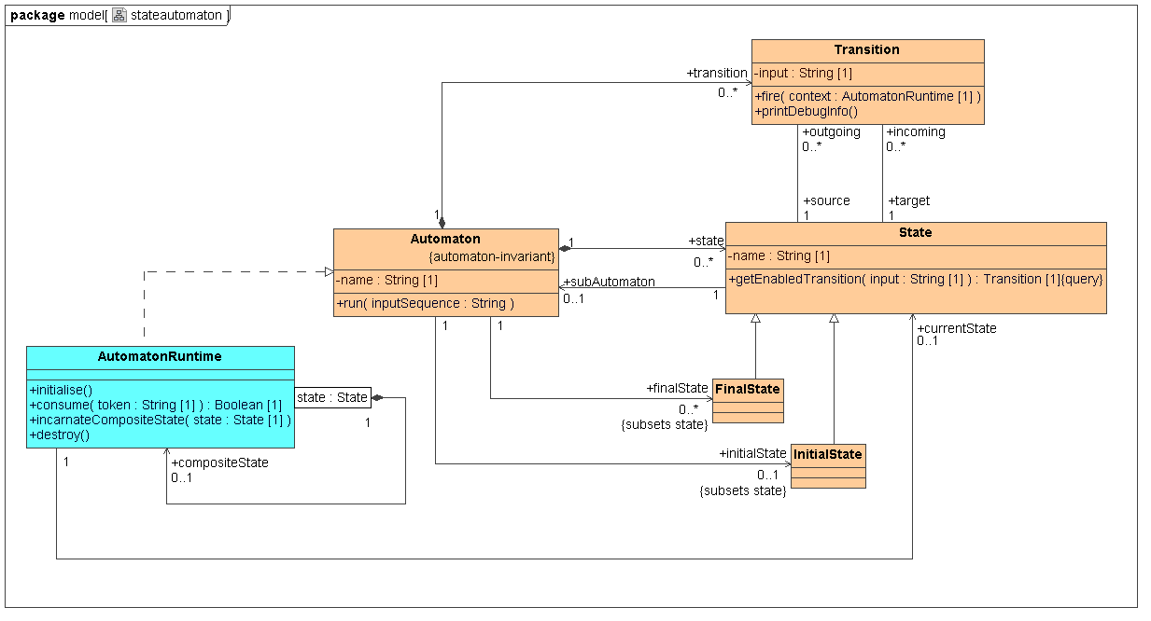
Language Meta-model

Slide 6
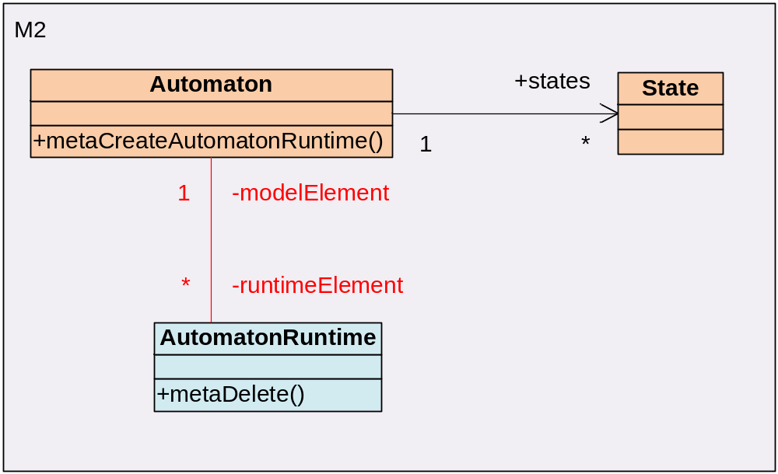
Language Meta-model

Slide 7
A MOF 2.0 for Java
CMOF-based meta-modelling framework
Required: generating repository code
Past: Java code (annoying recurring task)
Now: Ant tasks available -> see tutorial
Next: creating a test model
Automaton automatonX = factory.createAutomaton();
automatonX.setName("X");
InitialState startX = factory.createInitialState();
startX.setName("startX");
automaton.setInitialState(startX);
// ...
automaton.run("dbdecacf");

Slide 8
Execution Semantics
How to model execution semantics?
  Augment meta-model with operations
  Apply behaviour specifications
  Java code: straightforward
  OCL queries: MagicDraw UML
  Activities -> GEF-based editor

Slide 9
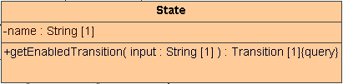
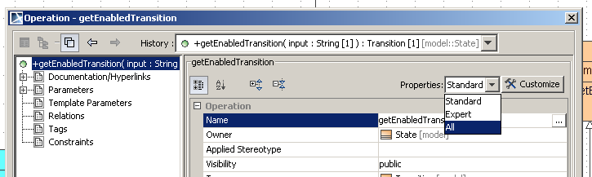
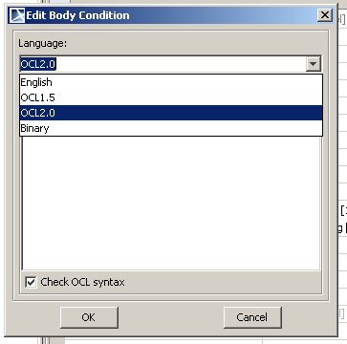
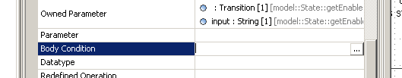
Behaviour Specification
Query operations
  OCL expressions
outgoing->select(t | t.input = input)->asOrderedSet()->first()

Slide 10
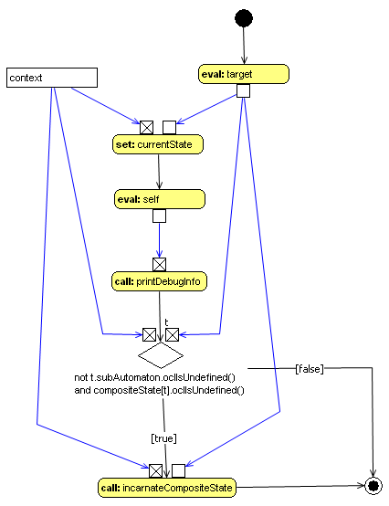
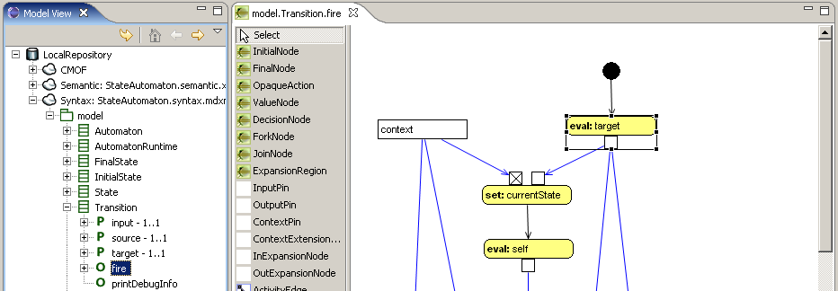
Behaviour Specification
Transition.fire(context: AutomatonRuntime)
Activities
Mof Action Semantics
(MAS)
Subset of activities
from UML

Slide 11
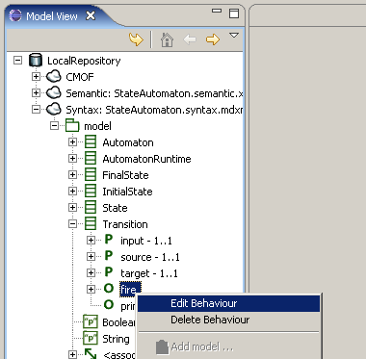
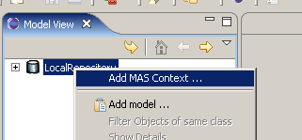
Behaviour Specification
StateAutomaton.masctx (java properties file)
syntax = StateAutomaton.syntax.mdxml
semantic = StateAutomaton.semantic.xml

Slide 12
Model Execution
Repository repository = Repository.getLocalRepository();
MasXmiFiles xmiFiles = new SimpleMasXmiFiles("resources/",
"StateAutomaton.masctx");
MasModelContainer modelContainer = new MasModelContainer(repository);
modelContainer.loadMasModel(xmiFiles.getMasFile());
modelContainer.loadSyntaxModelForExecution(xmiFiles.getSyntaxFile(),
"Package:model");
modelContainer.getSyntaxModel().
addJavaPackagePrefix("hub.sam.stateautomaton");
MasContext masContext = MasRepository.getInstance().
createMasContext(modelContainer);
MofModelManager testManager = new MofModelManager(repository);
testManager.setM2Model(modelContainer.getSyntaxModel());
MofModel testModel = testManager.createM1Model("test");
modelFactory testFactory = (modelFactory) testModel.getFactory();
MasExecutionHelper.prepareRun(repository, masContext, testModel);
Automaton automaton = createLargeTestModel(testFactory);
automaton.run("dbdecacf");

Slide 13
Model Execution
Repository repository = Repository.getLocalRepository();
MasXmiFiles xmiFiles = new SimpleMasXmiFiles("resources/",
"StateAutomaton.masctx");
MasModelContainer modelContainer = new MasModelContainer(repository);
modelContainer.loadMasModel(xmiFiles.getMasFile());
modelContainer.loadSyntaxModelForExecution(xmiFiles.getSyntaxFile(),
"Package:model");
modelContainer.getSyntaxModel().
addJavaPackagePrefix("hub.sam.stateautomaton");
MasContext masContext = MasRepository.getInstance().
createMasContext(modelContainer);
MofModelManager testManager = new MofModelManager(repository);
testManager.setM2Model(modelContainer.getSyntaxModel());
MofModel testModel = testManager.createM1Model("test");
modelFactory testFactory = (modelFactory) testModel.getFactory();
MasExecutionHelper.prepareRun(repository, masContext, testModel);
Automaton automaton = createLargeTestModel(testFactory);
automaton.run("dbdecacf");

Slide 14
Model Execution
Repository repository = Repository.getLocalRepository();
MasXmiFiles xmiFiles = new SimpleMasXmiFiles("resources/",
"StateAutomaton.masctx");
MasModelContainer modelContainer = new MasModelContainer(repository);
modelContainer.loadMasModel(xmiFiles.getMasFile());
modelContainer.loadSyntaxModelForExecution(xmiFiles.getSyntaxFile(),
"Package:model");
modelContainer.getSyntaxModel().
addJavaPackagePrefix("hub.sam.stateautomaton");
MasContext masContext = MasRepository.getInstance().
createMasContext(modelContainer);
MofModelManager testManager = new MofModelManager(repository);
testManager.setM2Model(modelContainer.getSyntaxModel());
MofModel testModel = testManager.createM1Model("test");
modelFactory testFactory = (modelFactory) testModel.getFactory();
MasExecutionHelper.prepareRun(repository, masContext, testModel);
Automaton automaton = createLargeTestModel(testFactory);
automaton.run("dbdecacf");

Slide 15
Model Execution
Repository repository = Repository.getLocalRepository();
MasXmiFiles xmiFiles = new SimpleMasXmiFiles("resources/",
"StateAutomaton.masctx");
MasModelContainer modelContainer = new MasModelContainer(repository);
modelContainer.loadMasModel(xmiFiles.getMasFile());
modelContainer.loadSyntaxModelForExecution(xmiFiles.getSyntaxFile(),
"Package:model");
modelContainer.getSyntaxModel().
addJavaPackagePrefix("hub.sam.stateautomaton");
MasContext masContext = MasRepository.getInstance().
createMasContext(modelContainer);
MofModelManager testManager = new MofModelManager(repository);
testManager.setM2Model(modelContainer.getSyntaxModel());
MofModel testModel = testManager.createM1Model("test");
modelFactory testFactory = (modelFactory) testModel.getFactory();
MasExecutionHelper.prepareRun(repository, masContext, testModel);
Automaton automaton = createLargeTestModel(testFactory);
automaton.run("dbdecacf");

Slide 16
Model Execution
Repository repository = Repository.getLocalRepository();
MasXmiFiles xmiFiles = new SimpleMasXmiFiles("resources/",
"StateAutomaton.masctx");
MasModelContainer modelContainer = new MasModelContainer(repository);
modelContainer.loadMasModel(xmiFiles.getMasFile());
modelContainer.loadSyntaxModelForExecution(xmiFiles.getSyntaxFile(),
"Package:model");
modelContainer.getSyntaxModel().
addJavaPackagePrefix("hub.sam.stateautomaton");
MasContext masContext = MasRepository.getInstance().
createMasContext(modelContainer);
MofModelManager testManager = new MofModelManager(repository);
testManager.setM2Model(modelContainer.getSyntaxModel());
MofModel testModel = testManager.createM1Model("test");
modelFactory testFactory = (modelFactory) testModel.getFactory();
MasExecutionHelper.prepareRun(repository, masContext, testModel);
Automaton automaton = createLargeTestModel(testFactory);
automaton.run("dbdecacf");

Slide 17
Model Execution
Repository repository = Repository.getLocalRepository();
MasXmiFiles xmiFiles = new SimpleMasXmiFiles("resources/",
"StateAutomaton.masctx");
MasModelContainer modelContainer = new MasModelContainer(repository);
modelContainer.loadMasModel(xmiFiles.getMasFile());
modelContainer.loadSyntaxModelForExecution(xmiFiles.getSyntaxFile(),
"Package:model");
modelContainer.getSyntaxModel().
addJavaPackagePrefix("hub.sam.stateautomaton");
MasContext masContext = MasRepository.getInstance().
createMasContext(modelContainer);
MofModelManager testManager = new MofModelManager(repository);
testManager.setM2Model(modelContainer.getSyntaxModel());
MofModel testModel = testManager.createM1Model("test");
modelFactory testFactory = (modelFactory) testModel.getFactory();
MasExecutionHelper.prepareRun(repository, masContext, testModel);
Automaton automaton = createLargeTestModel(testFactory);
automaton.run("dbdecacf");

Slide 18
Model Execution
Better leave this out.
Implementations Managers
semanticExtent: runtime, java
Extent semanticExtent = masContext.getMasModel().getExtent();
((ExtentImpl) semanticExtent).setCustomImplementationsManager(
new ImplementationsManagerContainer(
new ImplementationsManager[] {
new MultiLevelImplementationsManager(masContext.getMasModel().
getFactory()),
new ImplementationsManagerImpl() }
));
((ExtentImpl) m1Model.getExtent()).setCustomImplementationsManager(
new ImplementationsManagerContainer(
new ImplementationsManager[] {
new MASImplementationsManager(masContext, env),
new MultiLevelImplementationsManager(m1Model.getFactory()),
new OclImplementationsManager(),
new ImplementationsManagerImpl() }
));

Slide 19
Model Execution
Better leave this out.
Implementations Managers
semanticExtent: runtime, java
modelExtent: activities, runtime, ocl queries, java
Extent semanticExtent = masContext.getMasModel().getExtent();
((ExtentImpl) semanticExtent).setCustomImplementationsManager(
new ImplementationsManagerContainer(
new ImplementationsManager[] {
new MultiLevelImplementationsManager(masContext.getMasModel().
getFactory()),
new ImplementationsManagerImpl() }
));
((ExtentImpl) m1Model.getExtent()).setCustomImplementationsManager(
new ImplementationsManagerContainer(
new ImplementationsManager[] {
new MASImplementationsManager(masContext, env),
new MultiLevelImplementationsManager(m1Model.getFactory()),
new OclImplementationsManager(),
new ImplementationsManagerImpl() }
));

Slide 20
Model Execution
Repository repository = Repository.getLocalRepository();
MasXmiFiles xmiFiles = new SimpleMasXmiFiles("resources/",
"StateAutomaton.masctx");
MasModelContainer modelContainer = new MasModelContainer(repository);
modelContainer.loadMasModel(xmiFiles.getMasFile());
modelContainer.loadSyntaxModelForExecution(xmiFiles.getSyntaxFile(),
"Package:model");
modelContainer.getSyntaxModel().
addJavaPackagePrefix("hub.sam.stateautomaton");
MasContext masContext = MasRepository.getInstance().
createMasContext(modelContainer);
MofModelManager testManager = new MofModelManager(repository);
testManager.setM2Model(modelContainer.getSyntaxModel());
MofModel testModel = testManager.createM1Model("test");
modelFactory testFactory = (modelFactory) testModel.getFactory();
MasExecutionHelper.prepareRun(repository, masContext, testModel);
Automaton automaton = createLargeTestModel(testFactory);
automaton.run("dbdecacf");

Slide 21
Difficulties
Transition.fire(context: AutomatonRuntime)
Activity complexity
  Implicit control flow
  Many simple
  eval-actions
  Object flows all over the activity

Slide 22
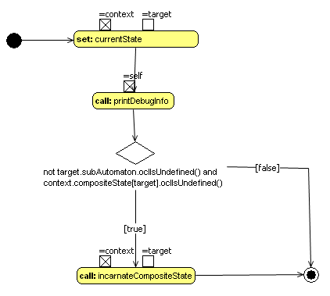
Difficulties
Transition.fire(context: AutomatonRuntime)
  Solution: local shortcut notation

Slide 23
Difficulties
Transition.fire(context: AutomatonRuntime)
Activity complexity
  local shortcuts
Bugs
  MAS Execution Engine
  -> Java Debugger
  Activities
  -> MAS Debugger

Slide 24
Debugging Languages
Language modelling
Near future:
debugger for MAS
Vision:
debugger model as a part
of the language model

Slide 25
Debugging MAS
First aims:
Read Eclipse debugger tutorial
Develop a running prototype
Set breakpoints at actions
Suspend execution
Show model state (MOF2-Browser)
6 weeks

Slide 26
Future Work
What is next?
Add described features to MASE
Update the AMOF2 tutorial page
?

Slide 27
End
Swarm out, read our tutorial
and develop your DSL :-)
Thank you.

